Slide 1
Title: Design An Interactive Dashboard For Business Stakeholders

Slide 2
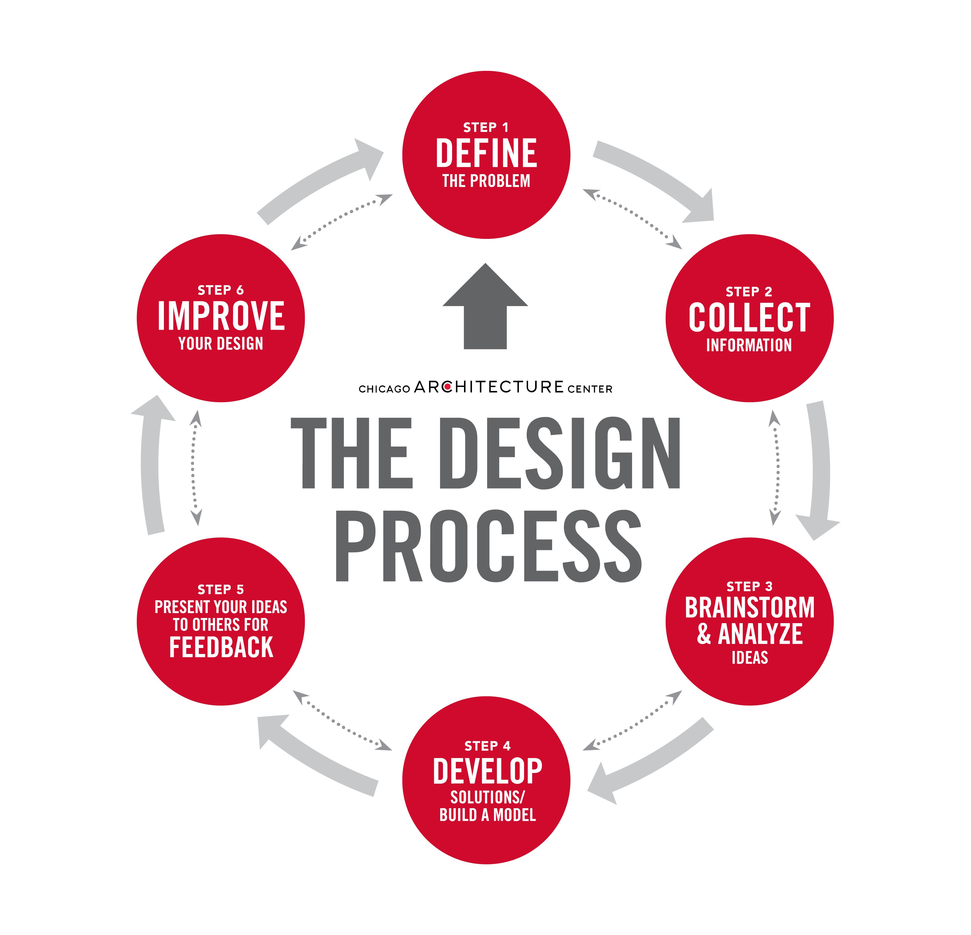
Introduction to Interactive Dashboards
Interactive dashboards are dynamic tools that visualize key business data for stakeholders.
They enable real-time data analysis, facilitating quicker decision-making processes.
Designing effective dashboards requires understanding stakeholder needs and data sources.
Notes:
Image source: https://i.pinimg.com

Slide 3
Understanding Stakeholder Requirements
Engage with stakeholders to identify their specific data needs and priorities.
Determine the key metrics and KPIs that align with business goals.
Consider user roles and technical familiarity to tailor dashboard complexity and usability.
Notes:
Image source: https://i.pinimg.com

Slide 4
Data Collection and Integration
Gather data from various sources such as databases, APIs, and spreadsheets.
Ensure data accuracy, consistency, and timeliness for reliable insights.
Use data integration tools to consolidate information into a centralized system.
Notes:
Image source: https://i.pinimg.com

Slide 5
Designing User-Centric Interface
Create an intuitive layout that highlights critical information prominently.
Use visual elements like charts, graphs, and maps to facilitate quick understanding.
Incorporate filters and drill-down features for personalized data exploration.
Notes:
Image source: https://i.pinimg.com

Slide 6
Choosing the Right Visualization Tools
Select visualization types that best represent the data, such as bar charts or heatmaps.
Use color schemes and labeling consistently to enhance clarity.
Leverage interactive components like sliders and clickable elements to increase engagement.
Notes:
Image source: https://i.pinimg.com

Slide 7
Ensuring Responsiveness and Accessibility
Design dashboards that function seamlessly across various devices and screen sizes.
Prioritize accessibility features to accommodate all users, including those with disabilities.
Test interface responsiveness regularly to optimize user experience.
Notes:
Image source: https://i.pinimg.com

Slide 8
Deployment and Maintenance
Deploy dashboards through secure platforms with appropriate access controls.
Provide user training and documentation to maximize adoption.
Regularly update data and features based on user feedback and evolving needs.
Notes:
Image source: https://i.pinimg.com

Slide 9
Conclusion and Best Practices
Effective interactive dashboards are vital for informed decision-making in businesses.
Focus on simplicity, clarity, and interactivity to enhance stakeholder engagement.
Continuously evaluate and improve dashboards to meet changing business requirements.
Notes:
Image source: https://i.pinimg.com

Slide 10
Thank You

